Slide 1

ICAOS Rules Training
For County Misdemeanor Cases
Interstate Compact for Adult Offender Supervision
Presented by:
Tim Strickland
Florida Deputy Compact Administrator

Slide 2
Presentation Objectives
Today you will learn about:
Overview of the Compact
Eligibility for Transfer
Transferring Supervision
Progress Reports
Reporting Violations Requiring Retaking
ICAOS Resources & Training Tools

Slide 3
Overview of the Compact
Purpose, Authority and Implications for Non-Compliance

Slide 4




Purpose of ICAOS
Protect the Rights of Victims
Promote Public Safety
Ensure Effective Supervision &
Rehabilitation
Control/Track Movement of Offenders
Notes:
Always important to highlight purposes of compact. No decisions or actions should be made that do not support these.
Promote Public Safety
Protect Victim’s rights
Ensure supervision techniques are consistent with instate offenders and in line with best practices of the supervising state; this includes same access to supervision, sanctions, and services
Through databases supported by each national office, we are tracking and controlling movement of offenders as they cross state lines

Slide 5
Interstate Compact for Adult Offender Supervision
ICAOS regulates how offenders are:
Transferred from one state to another
Supervised while on Compact Supervision
Returned to a sending state when supervision is not successful

Slide 6



Authority of an Interstate Compact
Florida entered the Compact with the passage of Florida Statute 949.07.
Authorized
Binding
Supersedes
The Compact is authorized by US Constitution & Crime Control Act
The Compact is binding upon all state authorities & citizens
The Compact rules supersedes conflicting state law

Slide 7
Implications of Non-Compliance
It is incumbent upon prosecutors, judges and other state officials to understand the requirements of the Compact and its rules, as well as the consequences of non-compliance.
Failure of state judicial or executive branch officials to comply with the Compact and its rules results in the state defaulting on its obligations under the Compact and could lead the Commission to take corrective or punitive action, including suit in federal court for injunctive relief.
7
Notes:
Explaining the consequences is important for stakeholder resisting compliance with compact requirements

Slide 8
Eligibility for Transfer

Slide 9


Why Offenders Transfer
ALL Transfers Require:
  Valid plan of supervision;
  Justification; and
  Reason
Most offenders are residents/have resident family-best chance for success!
Did you know?
110,000 Current Active Interstate Compact Offenders
60,000 cases transferring annually

Slide 10
ICAOS Creates Circumstances to
Promote Successful Supervision
Ensure Effective Supervision & Rehabilitation
Positive Relationships & Family Support
Life Stability
Means of Support & Employment
Resources/Programs
There is no “right” of convicted persons to travel across state lines or to serve one’s sentence in a particular state. See, Jones v. Harris, 452 U.S. 412 (1981); Meachum v. Fano, 427 U.S. 215 (1976)
Convicted persons have no right to control where they live; the right is extinguished for the balance of their sentence. Williams v. Wisconsin, 336 F.3d 576 (7th Cir. 2003), Pelland v. RI,317 F. Supp. 2d 26 (2004)
Notes:
Through ICAOS individuals on supervision provide opportunity for support and stability

Slide 11
Cycle of a Compact Case
Transfer Request
Notice of Arrival
Supervision in the Receiving state
Case Closure
Notice of Departure
Transfer Reply
1st Step: Determine Eligibility &
Reason for Transfer!

Slide 12
What Triggers the ICAOS?
Offender
Supervision
Relocate
Adult who commits a criminal offense (all felonies & specific misdemeanants)
Subject to ‘supervision’; and
Released to the community under the jurisdiction of:
  Courts
  Paroling Authorities
  Corrections
  Other Criminal Justice Agencies
2 Distinct criteria:
  Oversight exercised by a controlling authority, which includes:
    Courts
    Paroling Authorities
    Corrections
    Other Criminal Justice Agencies
  Required to monitor regulations or conditions, other than monetary
Offender means to remain in another state for more than 45 consecutive days in any 12 month period.
+
+
Notes:
Note eligibility for deferred sentenced offenders
Furloughed and preparole

Slide 13
Eligible Misdemeanants
Person incurred direct or threatened physical or psychological harm.
Sentence = 1+ years of supervision
AND
Instant Offense Includes
One or More
Use or possession of a firearm involved.
2nd or subsequent conviction of driving while impaired by drugs or alcohol
Sex offense requiring registration in the sending state

Slide 14
Transferring Supervision

Slide 15

What Requirements for Transfer?
1
2
3
4
Time Remaining on Supervision
>= 90 calendar days or an indefinite period of supervision remaining
Valid Plan
Terms & conditions of supervision
Residence
Employment/Means of Support
Substantial Compliance
No initiation of revocation proceedings by Sending State
Justification/Reason
Resident
Family
Employment
Military Orders
Discretionary/ Correctional Sense
Notes:
Other eligibility criteria for transfer must illustrate that relocating to another state is offender’s best chance for success. Offenders must have a good plan, not be in violation status in the sending state and most have ties to the receiving state as being a resident (living in that state prior to committing their offense) or have family support.
As clearly stated in case law, no convicted person has a right to server his or her sentence in another state.
It’s imperative offender’s understand this when allowed to transfer and that the compact is established to provide a legal mechanism for the offender to live and be supervised in a receiving state, not be an obstacle.

Slide 16
Mandatory versus Discretionary Transfers
All Transfers should illustrate
Successful Completion of Supervision
Public Safety
Rehabilitation of Offenders
Protect Rights of Victims
Mandatory
Discretionary
Receiving State must accept supervision if:
Mandatory criteria transfer is met; and
Information is verified; and
Plan is valid; and
  Acceptable for in state offender
Required documentation is provided
Receiving state may accept or reject supervision in a manner consistent with the purpose of the compact
Sending state must justify “WHY”
Rejections must include specific reasons for rejection

Slide 17
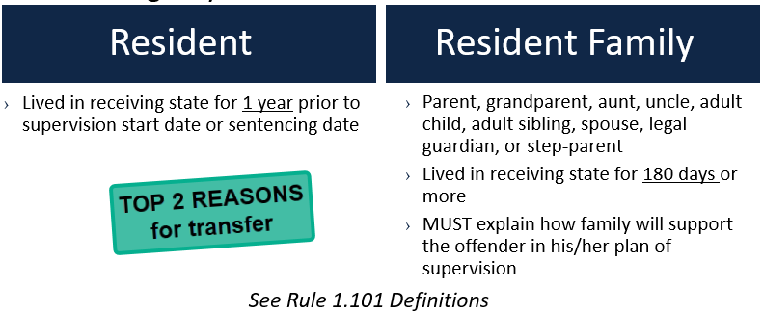
Reason for Transfer
If the offender is not a resident or does not have resident family in the receiving state, call the Florida Interstate Compact Office at 850-717-3487 to discuss or email fl.compact@fdc.myflorida.com for help.

Slide 18
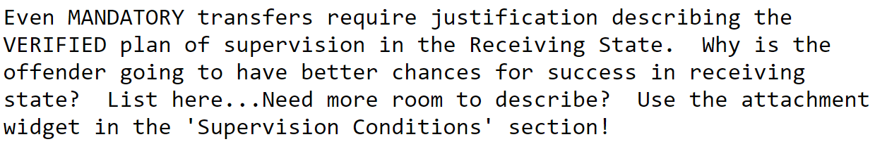

Justification for Transfer
Detailed VERIFIED justifications!!!
Why is the offender going to be more successful in the Receiving State?
Describe support system
Means of support
Living situation
Use clear, concise language; no abbreviations

Slide 19
Required Attachments
Copy of signed Offender Application
Instant Offense DETAILS
Color Photo
Conditions of Supervision (Order)
Financial Obligations (order by Court)
Supervision history (only if currently on supervision for more than 30 calendar days)
PSI (if it exists or is not prohibited for distribution)
If Applicable: Sex offender registration requirements Orders of restriction Known protective orders Known gang affiliation Prison discipline and mental health history of last 2 years

Slide 20
Offense Details
Detailed circumstances of instant offense (i.e., offense report with who, what, when, where)
Offense reports just stating that the offender was arrested on a warrant are not sufficient
Attach details of offense (Narrative, Police Report, etc.)

Slide 21
Sex Offenders
3 Types per ICAOS Definition
Additional Transfer Requirements
Following acceptance
If Available:
Assessment Information
Victim Information
  Demographics
  Statement
Supervision or Treatment plan - current or recommended
If requested (and available,) provide to the receiving state within 30 days
Risk Needs Score
Information related to PRIOR sex offenses
Other documents to assist in supervision
Registered in the sending state
Required to register in the sending state
Offender who is under sex offender terms and conditions in the sending state

Slide 22
Prior to submitting ANY request to a receiving state, the Florida offender must pay the required application fee.
Interstate Compact Checklist: The following items are in this packet:
Transfer Request Form (submit as word document attachment);
Signed Offender Application for Interstate Compact Transfer form;
Supervision Orders;
Gang information;
Detailed circumstances of instant offense (i.e., offense report with who, what, when, where)
Judgment and Commitment Documents;
Pre-Sentence Investigation (if available);
Information relating to court ordered financial obligations;
Current victim information included name, address;
Any known orders restricting contact with any person or any person's contact with the offender.
Email the COMPLETE packet to fl.compact@fdc.myflorida.com
Submission of Transfer Request to the FL Compact Office

Slide 23
Prior to submitting ANY request to a receiving state, the Florida offender must pay the required application fee.
Effective 07/01/2022 all individuals applying for transfer of supervision through the Interstate Compact for Adult Offender Supervision from Florida must pay an application fee.
The Application Fee can be paid by submitting a USPS Money Order or Cashier’s Check payable to the Florida Department of Corrections.
Only a USPS money order or bank cashier’s check may be submitted for payment.
DO NOT send cash or a personal or business check.
A copy of the notice document MUST be included with the payment.
Send USPS money order or bank cashier’s check to:
Florida Department of Corrections
COPS / ICOTS Application Fee
P.O. Box 12300
Tallahassee, FL 32317-2300
Application Fee

Slide 24

No Travel Prior to Acceptance
Investigation Period
Up to 45 days
Reporting Instructions Exceptions:
Probationer Living in Receiving State at the time of Sentencing
Military Members/Veterans Receiving Treatment/Employment Transfer
Other verified Emergency Situations (both states must agree)
OTHER: Daily travel (border) allowed for medical/employment ONLY must return daily and notify of travel via ICOTS
Notes:
Ris Provides temporary permission for offender to be in a receiving state during the investigation.

Slide 25

Reporting Instructions
Provides permission for offender to be in the receiving state PRIOR to acceptance. Wait on approval of reporting instructions before offender can travel.
Call the Florida Interstate Compact Office at 850-717-3487 to discuss if the offender qualifies to request reporting instructions.
Qualifying for mandatory reporting instructions does NOT automatically qualify as a mandatory transfer

Slide 26

Living in Receiving State vs. Compact Definition of Resident
Living in Receiving State
RI REASON
Resident
TRANSFER REASON
  Lives in the receiving state when sentenced to probation in the sending state and needs to go home after sentencing or sentenced remotely
Lived in receiving state for 1 year (continuously and immediately) prior to supervision start date or sentencing date

Slide 27
Reporting Instructions
Living in the Receiving State at the Time of Sentencing
Requests must be submitted within 7 days of:
Initial sentence to probation supervision, OR
release to probation supervision from incarceration (6 months of less,) OR
disposition of violation/revocation hearing
TIP: Submit Transfer Request prior to release. If approved, request for reporting instructions is not necessary
        Be sure to inform offender of the
        Reporting Instructions when received!!!

Slide 28
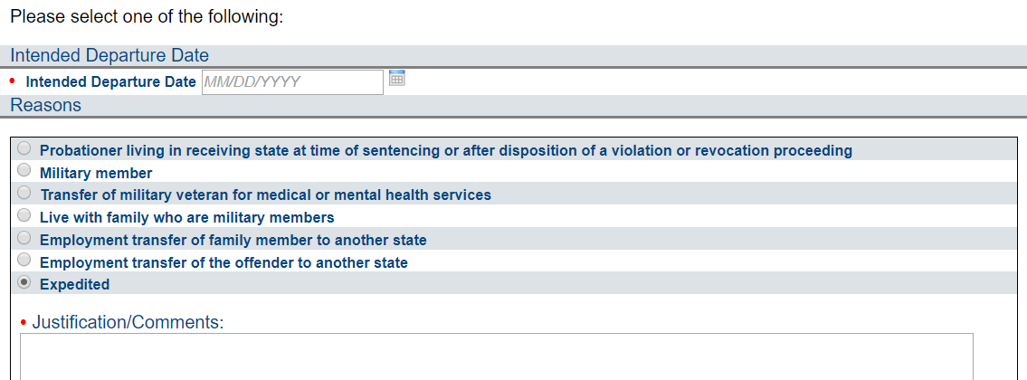
Reporting Instructions Documentation Requirements
Verify residency PRIOR to issuing a travel permit.
Military Orders
Approval/Referral
Employer documentation stating the transfer is directed by employer to maintain employment (NOT for new job opportunities/promotions)
Any other emergency reason. Both states MUST agree
ALWAYS JUSTIFY!
Sex Offender (All reasons) must include:
Offense details
Conditions of supervision
Contact Restrictions
Victim Information (Name, Sex, Age, Relationship)
Notes:
LIRS: Provide documentation

Slide 29

Reporting Instruction Timeframe Requirements
Receiving State
Sending State
  Respond to Reporting Instructions Requests
  2 business days
  Sex Offenders: 5 business days
  Send Transfer Request Timely!
  15 business days
  7 business days after approved expedited reporting instructions

Slide 30
Transfer Reply
All County Misdemeanor Cases will be assigned to a member of the Florida Compact Office.
When a transfer reply is received the submitting County Misdemeanor Officer will be notified by email from the Florida Compact Office with the decision and instructions on actions needed.

Slide 31


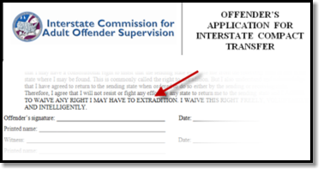
Compact Supervision Elements
Duration
Conditions
Waiver
Sentencing Authority in the Sending State determines duration of Supervision
Offender agrees to conditions imposed by BOTH Sending & Receiving States
Offender applying for transfer WAIVE rights for extradition
Notes:
As a precondition to transfer supervision, ALL offenders must sign the offender application for transfer agreeing to waive extradition from any state. This is EXTREMELY IMPORTANT as it replaces the need for an extradition hearing in the Receiving State and the need for a Governor's warrant by the Sending State in order to apprehend an offender.
This form clearly states, “…I will not resist or fight any effort by any state to return me to the sending
state and I AGREE TO WAIVE ANY RIGHT I MAY HAVE TO EXTRADITION. I WAIVE THIS RIGHT FREELY,
VOLUNTARILY AND INTELLIGENTLY.”

Slide 32

Compact Supervision in a Receiving State
Supervision standard consistent with similar offenders sentenced in the Receiving State
Same programs, incentives, sanctions/interventions
‘Participation in the ICAOS ensures not only the controlled movement of offenders under community supervision, but also that out-of-state offenders will be given the same resources and supervision provided to similar in-state offenders including the use of incentives, corrective actions, graduated responses and other supervision techniques’
Notes:
Once allowed to transfer, receiving states have to provide supervision consistently in how they would supervised an offender sentenced in the receiving state. Although most states fulfill this requirement well under the compact requirements, it can be a training issue for stakeholders involved in supervision decisions or rehabilitation programs.

Slide 33

Requirements during Supervision
Progress Reports
Registration
Fees
Regular supervision updates
  Requests for PR’s from sending state (via specialized CAR) must be sent within 30 calendar days
Notify when adding or updating conditions
Inform of compliant AND non-compliant behavior
Receiving states required to assist the sending state
  E.g., DNA Testing
Sending States
  May impose an application fee
  May NOT impose supervision fees after transfer
  Solely responsible for collection of financial obligations
    E.g., court fees, child support, restitution, etc.
Receiving States may impose supervision fees
  AFTER acceptance
  Consistent with fees paid by instate offenders
https://www.interstatecompact.org/resources/fees

Slide 34
Progress Reports
Keep Sending State informed!
  Supervision Update
  Ability to add new conditions imposed
  Documentation on compliant & non-compliant behavior that DOES NOT require retaking
  Report New Arrest
Note: If reporting BOTH new arrest & violation of conditions, 2 progress reports may be needed
When a progress report is received for a County Misdemeanor Case it will be submitted to the County Misdemeanor Office by the Florida Compact Office via email with instructions on actions needed.
If the Misdemeanor County Officer needs to request a progress report from the receiving state, send an email to the Florida Compact Office at fl.compact@fdc.myflorida.com with the request and provide any specific information needed. Requested progress reports are to be completed within 30 days of receiving the request in the receiving state.

Slide 35
Warrants, Discretionary Retaking &
Reporting Violations Requiring Retaking
Violation Report = Mandatory Retaking!!!

Slide 36
Retaking Definition
Sending State:
  Issue Compact compliant ‘warrant’
  Incur cost of Retaking Offender
Receiving State:
  Incur cost to incarcerate pending retake
  May require establishing PC
Offenders subject to retaking shall not be entitled to bond/release conditions pending retaking Rule 5.111

Slide 37
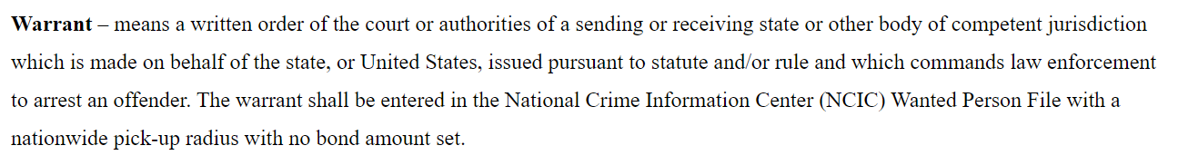
Warrant Definition
Warrants are required when:
Offender fails to arrive as instructed
Receiving State requires retaking and
  Offender is reported as an absconder; or
  Offender is subject to mandatory retaking for behavior requiring retaking (exception exists to allow return in lieu of retaking See Rule 5.103; or)
  Offender commits a new felony or violent crime
Sending State discretionarily retakes

Slide 38
Discretionary Retaking & Mandatory Retaking
Discretionary
Retaking
Mandatory
Retaking
Initiated by the SENDING STATE
  Typically sentencing officials such as Courts/Parole Boards
Requires Sending State Notification via Discretionary Retaking Activity
  ONLY retaking via Warrant
    Submit within 15 business days of warrant issuance
  Return in lieu of retaking? Request RI’s DO NOT USE Disc Retaking Activity
Warrant Entry into ICOTS
Invoked by the RECEIVING STATE for:
  Revocable behavior
  Commission of new felony/violent crime
  Absconder
Documentation illustrates all efforts to correct non-compliant behavior has been exhausted and receiving state would revoke supervision
  Probable cause (waiver or hearing) may be required unless violation is a new crime conviction

Slide 39
Behavior Requiring Retaking
“behavior would rise to level of revocation of supervision because…”
Utilize Violation Report
Utilize Progress Report
Act or pattern of Non-Compliant Behavior
Would Request Revocation of Supervision
RETAKING
Unsuccessful Supervision Documented
Non-Compliant Behavior
Would Apply Sanctions OR Corrective Actions
Address Behavior & Report to Sending State

Slide 40

Court/Parole Board in your jurisdiction revokes SUPERVISION for similar behavior
Extending/modifying supervision term is NOT revocation
RETAKING
Unsuccessful Supervision Documented
Exhausted options to address non-compliant behavior
Revocation of SUPERVISION would be likely for instate similar offender
Revocation is NOT simply reporting a condition violation to the court.
Revocation: Sentencing authority terminates supervised release and incarcerates the offender
Notes:
Absconder apprehended, but sending state could not pick up or transport-
Receiving state agreed to resume supervision until such a time as sending state could make arrangements

Slide 41
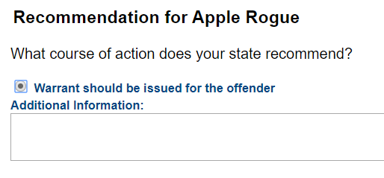
Use of Violation Report Requires Retaking
Reports “behavior requiring retaking”
Recommends revocation of supervision
Enforces retaking rules
Manages retaking
  All communication regarding violations via Violation Reports & Violation Addendums

Slide 42
Violation Reports Requiring Retaking
Receiving State
Sending State
Submit Violation Report within 30 calendar days of discovery or determination supervision is no longer a viable option
  Include Supporting Documentation
    Police reports
    Toxicology reports
    Preliminary findings
    Details/Status of infraction
  Incentives/Sanctions applied and responses
  Ensure ‘Availability’ Status is correct
Respond within 10 business days
(If a violation report is received by the Florida Compact Office it will be emailed to the Misdemeanor County Office with instructions on what actions are required by the Compact.)

Slide 43
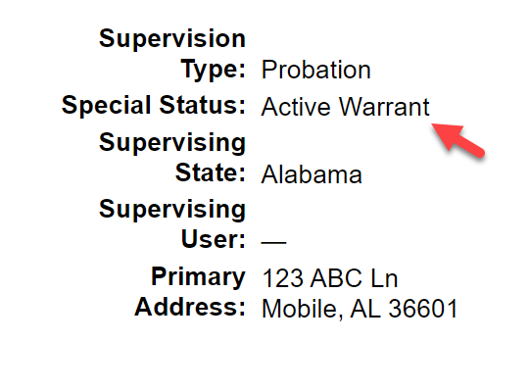

Absconder Violation Reports
Abscond means to be absent from the offender’s approved place of residence and employment; and failing to comply with reporting requirements.
Rule 1.101 Definitions
Receiving State
Sending State
Offender not located after completing the following activities:
Document ALL communication attempts
Conduct a field contact at last known place of residence;
Contact last known place of employment; if applicable;
Contact known family members and collateral contacts (must include those identified in original transfer request.)
Submit Violation Report (DETAIL Activities )
Submit Case Closure
Issue Warrant within 15 business days
Enter Warrant Details on Offender Profile

Slide 44
Warrant Requirement
1
Violation Report Requiring Retaking
=
WARRANT
ONLY Exception: after report of ‘Behavior Requiring Retaking,’ Sending state can order the return of the offender (via reporting instructions) in lieu of retaking
Warrant – means a written order of the court or authorities of a sending or receiving state or other body of competent jurisdiction which is made on behalf of the state, or United States, issued pursuant to statute and/or rule and which commands law enforcement to arrest an offender. The warrant shall be entered in the National Crime Information Center (NCIC) Wanted Person File with a nationwide pick-up radius with no bond amount set.
All warrants issued by any Florida Court must meet the Compact requirements.
2
Warrant must be Compact Compliant (within 15 business days of OVR receipt)
No Bond
Nationwide
Entered into NCIC

Slide 45
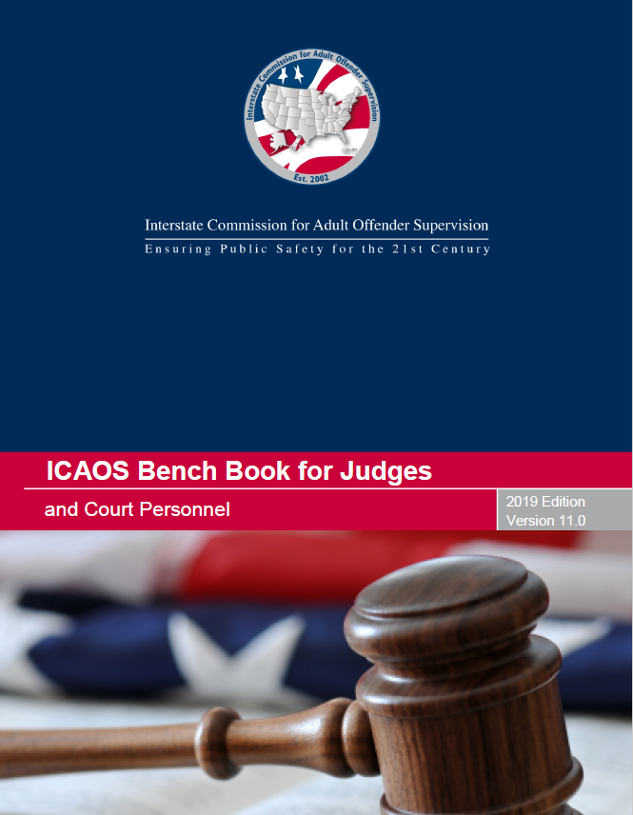

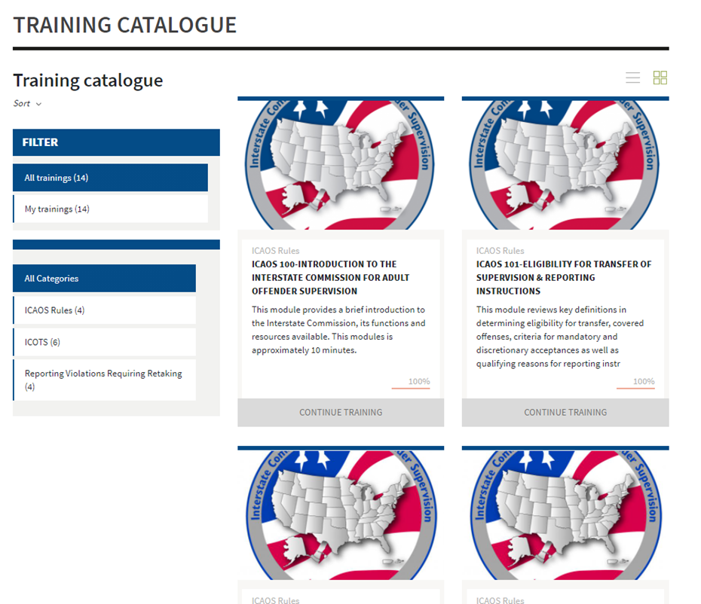
Contact the Florida Compact Office
Resources
Email
fl.compact@fdc.myflorida.com
Phone
850-717-3487
Website
www.interstatecompact.org
https://www.interstatecompact.org/core-search
https://www.interstatecompact.org/bench-book

