Slide 1
Probation Law Class
Presenter: State Attorney Andrew Bain

Slide 2
Balancing Rehabilitation & Public Safety
Adult Probation
Juvenile Probation
Accountability and Recidivism Reduction:
Community Safety: Ensuring probation is adequate for community safety.
Education: Courses on substance abuse, impulse control, life skills.
Employment and Training: Job training, financial literacy, literacy programs.
Support Services: Addressing poverty, addiction, mental health needs to reduce recidivism.
Balancing Safety and Rehabilitation:
Community Safety: Ensuring probation is adequate for community safety.
Service Needs: Requesting PDR from DJJ, listening to parents, providing counseling.
Post Commitment Probation: Follow-up services for successful reintegration.
Collaboration with DJJ: Using recommendations from DJJ and working with JPOs.

Slide 3
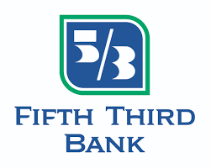
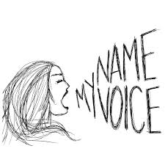
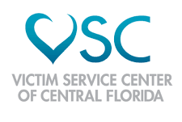
Community Partnerships
Notes:
Community Partnerships: We have formed new official partnerships or strengthened existing ones with more than two dozen local organizations across our circuit. They are working with us on everything from our diversion to prevention programs. I have said it before, criminal justice is a community issue and we cannot and should not do it alone.
Names and logos
CareerSoucre of Central Florida
Victim Services of Central Florida
Operation New Hope
Hope Partnerships
United Against Poverty
Recovery Connections
Page 15
Victoria’s Voice Foundation
Figgers Foundation
University of Central Florida
Florida Economic Consortium
Stono Institute
Fifth Third Bank
Orlando Serve Foundation, “He Got Up!”
Central Florida Urban League
Cornerstone Connections
Florida Safety Council
Orange and Osceola County School District
Human Trafficking partners: United Abolitionist, My Nam My Voice, Samaritan Village, Flite, Inside Out Jail Ministries, One More Child, Planned Parenthood, 121 Hope Northland Church, Aspire

Slide 4
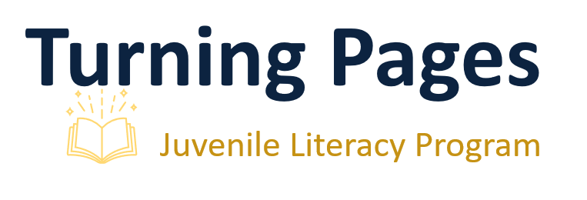
Supporting Probation Success
Juvenile Programs
Turning Pages Literacy Program
12-week intensive literacy program
DV component added to Changing Adolescent Perspective (C.A.P.) DV
Career Exploration Program with OCPS
Parent Series targeting at-risk and DJJ youth

Slide 5
Mental Health or Substance Abuse Cases
Adult Approach
Post-Plea Problem Solving Courts
Treatment Programs
Inpatient drug treatment
Peer-to-peer programs
Future Goal: Expand alternative sanctions program for technical offenses.

Slide 6
Mental Health or Substance Abuse Cases
Juvenile Approach
Evaluations and Treatment
State requests mental health or substance abuse evaluations and treatment.
Open to non-DJJ residential programs for treatment if found by DJJ or parents.
Future Goals:
Establish Juvenile Mental Health and Drug Court in 9th Circuit.
Focus on specialized attention and proper treatment for youth.

Slide 7
Factors for Recommending Probation
Adult Cases
Offense
Community Resources to address public safety
Criminal History
Likelihood of Success
Juvenile Cases
Age
Offense
History
Provided Services

Slide 8
Determining Probation Conditions
Adult Case Considerations:
Law
Offense
Community Resources to address public safety
Criminal History
Restitution and Restorative Justice
Juvenile Case Considerations:
Process
PDR Requests: State, Defense or Court can request pre-dispositional report (PDR) from DJJ
Standard Conditions: Curfew, school attendance or GED, obey household rules
Additional Services guided by case facts and may include:
Anger management class or individual counseling
Grief counseling
Letter of apology and no contact orders for victim crimes

Slide 9
Probation Violations and Legal Consequences
Adult Violations
Technical Violations
First-Time Offense: Max 90 days jail
Alternative Sanctions
New Law Offense
Jail time, community service, inpatient treatment or revocation with prison sentence.
Violent Felony Offender of Special Concern
No Bond: Must remain in jail until resolution and danger hearing.
Maximum Sentence: If found dangerous, receive max prison sentence.

Slide 10
Probation Violations and Legal Consequences
Juvenile Violations
Felony, New Law, Violent Offense or Absconding DJJ Supervision
Request commitment staffing.
Curfew Violations
Additional community service.
Oaks Probation (Orange County)
Probation and therapy.
Alternative Sanction Matrix (minor violations)
Add community service hours, essays, curfew restrictions.
New Law Non-Violent Misdemeanor
Extended Probation with additional sanctions, depending on history.

Slide 11
State Attorney’s Role in Probation Revocation
Adult Hearings
Juvenile Hearings
Review and Filing
Submission of Violation of Probation affidavit and warrant.
Witness List
Burden of Proof
Must prove violation by the greater weight of the evidence.
Hearsay allowed but must link to admissible evidence.
Officer Involvement
Probation or community control must be present.
Review and Filing
Reviews JPO's Violation of Probation affidavit.
Files Petition of Revocation of Probation (VOP).
New Offenses
Files Petition of Revocation for open probation cases.
Hearing Process
Presents case, witnesses (including JPO), and evidence.

Slide 12
Probation Law Changes
Juvenile
Supervised Release Extension
Previous Duration: 21 days
Current Duration: Up to 75 days
Impact
Longer community supervision
Successful supervised release considered in JPO recommendations to the SAO.

Slide 13
Insights for Defense Attorney
Adult Cases
Juvenile Cases
Communication: Essential for effective collaboration with the State Attorney's Office (SAO).
Mitigation: Send promptly with witness contacts.
Communication: Crucial for updates and resolution.
Additional Information: Defense should provide details on why/how the violation occurred.
Substantial Violations
Defense can provide input on reasons for additional community opportunities when staffing requested.

