Slide 1
MISSION ACCOMPLISHED
THROUGH PROBLEM SOLVING COURTS
2024 Annual Institute of the Florida Association of Community Corrections
July 24, 2024, Kissimmee, Florida
Judge Alicia L Latimore, Florida Ninth Judicial Circuit
Valori Oliver, Florida Dept. of Corrections Correctional Probation Supervisor
Emil A Caron, Certified Peer Support Specialist, La Amistad Behavioral Services
Notes:
Opening = Valori
Introductions each person introduces themselves and a quick little bio

Slide 2
How probation looks in psc
OUR MISSION: Provide a continuum of services to meet the needs of those entrusted to our care creating a safe and professional environment with the outcome of reduced victimization, safer communities and an emphasis on the premium of life.
Notes:
Valori Oliver LEADS

Slide 3
Role and responsibilities of officers
Role:
Protect the community by supervising offenders and reporting non-compliance to the sentencing or releasing authority.
Enforce standard conditions of supervision stipulated by statute and any special conditions imposed by the court or sentencing authority.
Conduct investigations, including pre-sentence investigations, other state investigations and violation reports.
Goal:
Officers make appropriate referrals to assist the offender with resources available to complete their term of supervision successfully.
Notes:
Valori Oliver LEADS
Probation Services https://fdc.myflorida.com/cc/index.html
The Office of Community Corrections mission is to protect the community by supervising offenders and reporting non-compliance to the sentencing or releasing authority. Correctional probation officers enforce standard conditions of supervision stipulated by statute, as well as special conditions imposed by the court or sentencing authority, including victim restitution, substance abuse and/or mental health treatment programs, and other sanctions or restrictions. Correctional Probation Officers also supervise offenders placed on pre-trial intervention. Offenders are monitored through field contacts at their residences, employment sites and other locations in the community. Officers conduct investigations and violation reports. Officers make appropriate referrals to assist the offender with resources available to complete their term of supervision successfully. The office also manages offenders received for supervision from other states through interstate compact agreements.

Slide 4
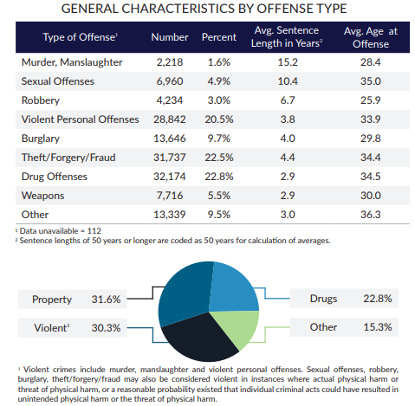
The Numbers
In 2023 Community Corrections supervised 145,000+ offenders
Offenders supervised by probation officers in 130 offices across Florida
Officers also supervise offenders placed on pre-trial intervention
From July 2022-July 2023 19,132 were placed on supervision for Drug Offenses
Almost 30% of community supervision offenders had drug offenses.
Notes:
Valori Oliver LEADS
Annual_Report_22-23_V10.pdf (ccplatform.net)

Slide 5
Conditions of supervision
Notes:
Valori Oliver Leads
Standard Conditions of Supervision
Reporting (monthly, weekly, other)
No Weapons
Do not use intoxicants
Do not associate with persons engaged in criminal activity.
Court cost and fees
Random Drug testing
Special Conditions
Mental Health Evaluation
Substance abuse evaluation
No Contact with the victim
Community Service Hours
Transition into Judge Latimore.

Slide 6
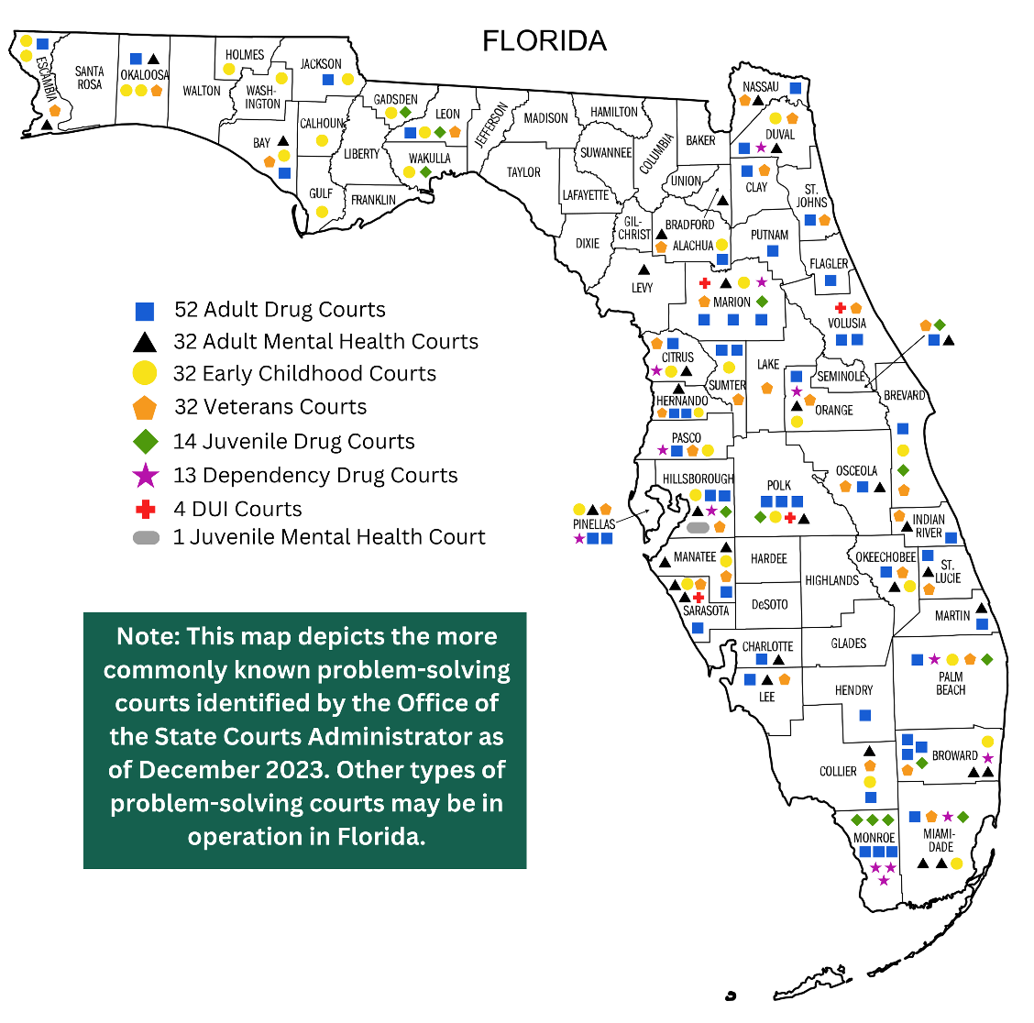
SPECIAL CONDITION Problem solving courts
Specialized docket for non-violent offenders in need of treatment related to a substance abuse or mental health condition.
PSCs use a non-adversarial team approach with the goal of assisting people with recovery therapy enabling them to become productive citizens.
Notes:
Lead = J Latimore

Slide 7
Psc Program Goals
Reinforce recovery
Through early, continuous and intensive judicially supervised treatment, random drug testing, and the use of graduated incentives/sanctions
Reintegrate
Help participants give back to the communities that have been affected by their actions and improve their life skills to enable them to become productive members of society
Reduce Recidivism
Recidivism rates for graduates: 12% - 17%
Notes:
Lead = Judge Latimore

Slide 8
Criminal Court Problem Solving Programs
Adult Drug Court/Opioid Court
Mental Health Court
Veterans Treatment Court
Notes:
Lead = J Latimore

Slide 9
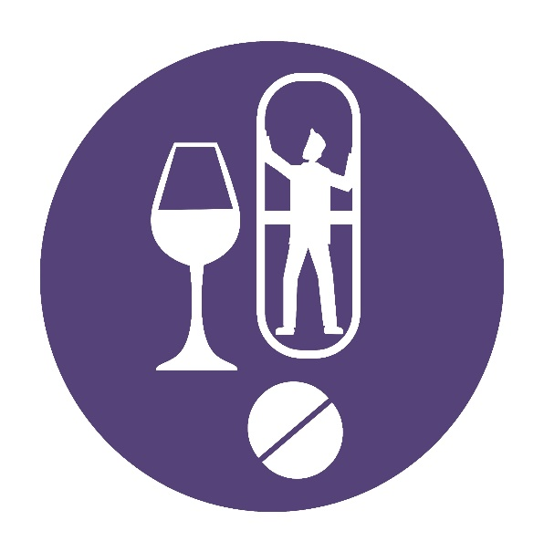
Adult Drug Court / opioid COURT
Eligibility
Adults who have been arrested with an acceptable Felony or Misdemeanor offense.
Victim Approval (if applicable)
Score less than 60 points
Program Requirements
Court every two weeks
Frequent and random drug testing
Group and Individual Counseling
Pro-Social Activities
Monthly Probation check-in as mandated
Meet with Case Manager
Meet with Peer Support Specialist
Ancillary or “Wrap around” services as needed
Additional classes or conditions determined by State Attorney Office
Notes:
Lead = J Latimore

Slide 10
Mental Health Court
Eligibility
Adults who have been arrested with an acceptable Felony or Misdemeanor offense and who have a permissible Mental Health Diagnosis.
Victim Approval (if applicable)
Mental Health evaluation within 12 months
Program Requirements
Court every two weeks
Frequent and Random Drug Testing
Mental Health follow up (Medication Appts)
Treatment as recommended
Monthly probation check-in as mandated
Meet with Case Manager
Ancillary or “Wrap Around” services as needed
Meet with Peer Support Specialist
Additional classes or conditions determined by State Attorney Office
Notes:
Lead = J Latimore

Slide 11
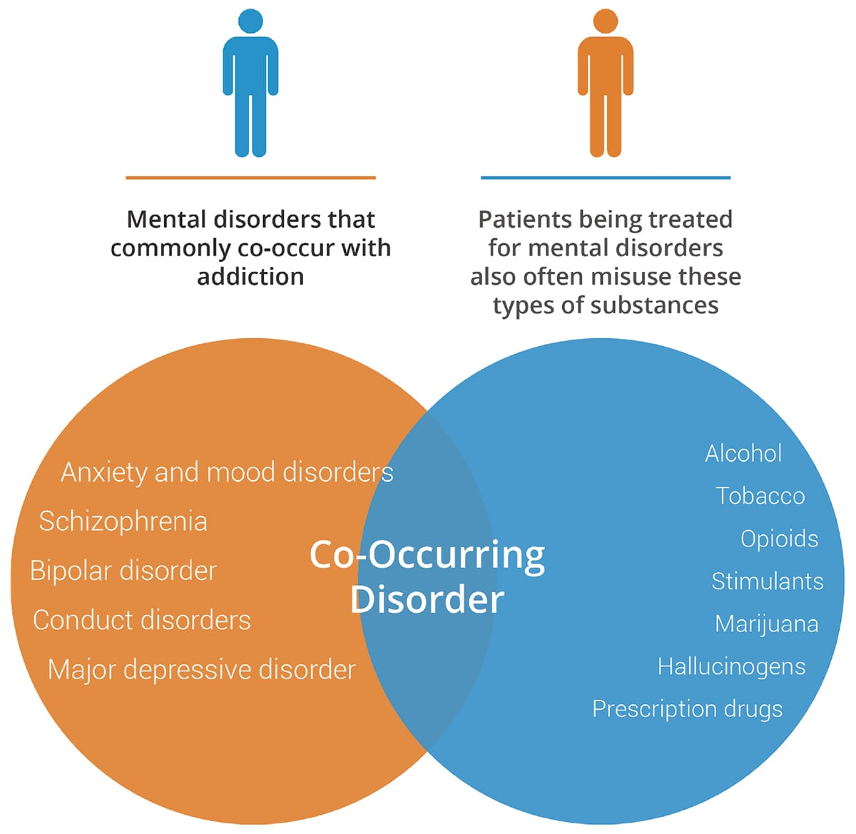
Understanding a Co-Occurring Disorder & Why it Matters
People with SUD at risk for developing one or more conditions or chronic diseases
People with mental illness more likely to experience SUD
No specific or unique combinations of mental and substance use disorders
Some individuals with mental disorders may misuse several different types of substances
OUD has the highest mortality rates of all psychiatric disorders
Notes:
Lead = J Latimore

Slide 12
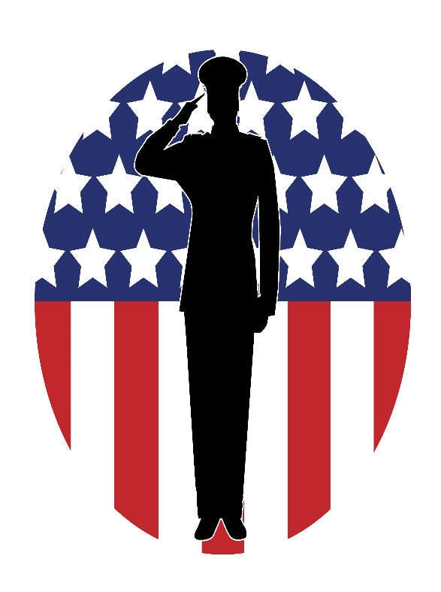
Veterans treatment court
Eligibility
Adults who have been arrested with an acceptable Felony or Misdemeanor offense and have served in the US Armed Services, Allied Forces, or Military Contractors.
Victim Approval (if applicable)
Program Requirements
Court every two weeks
Drug Testing as needed
VA services and support
Mental Health and Substance Abuse screening
Group and Individual Counseling (if recommended)
Monthly Probation check-in as mandated
Meet with Case Manager
Meet with Mentor/Peer Support Specialist
Ancillary “Wrap Around” Services as needed
Additional classes or conditions determined by State Attorney Office
Notes:
Lead = J Latimore

Slide 13
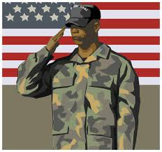
trauma & Post-traumatic stress disorder (ptsd)
PTSD a trauma-driven and/or stressor-related disorder that may develop after exposure to actual or threatened death, serious injury, or sexual violence
Brain continues to react with excessive fear and nervousness after experiencing or witnessing trauma/terrifying event and may remain in state of hyper-alert overdrive
Symptoms:
Nightmares, Flashbacks, Triggers
Jittery or overly alert, feeling angry or irritable, difficulty sleeping
Avoidance from crowds, certain smells, sights, sounds, memory of event
Lost interest in things once enjoyed, feeling guilty or ashamed, unable to trust others
Notes:
Lead = J Latimore

Slide 14
psc REFERRAL PROCESS
Arraignment/Status Hearing
Referral
Program Screening
Treatment Evaluation
Set on PSC docket for
Contract Signing/Court Order Entered
Notes:
Lead = J Latimore

Slide 15
Diversion VS Post plea tracks
Diversion
State Attorney
No plea to charges
PSC Agreement & conditions
Case dismissed/nolle prosequi
Post Plea
Trial Court
Plea to charges/VOP
Placed on probation
Withhold adjudication
Early termination of probation
Notes:
Lead = J Latimore

Slide 16
Integrated
Team
Approach
Probation
Corrections
Judge
Community
Based
Treatment
Attorney
Drug Testing
Peer
Support
Specialists
PSC
Participant
Dept of
Veterans Affairs
or
Other Agencies
Family
Friends
Community
Non- adversarial
Case Management
Notes:
Lead = Judge Latimore
Transition to Valori

Slide 17
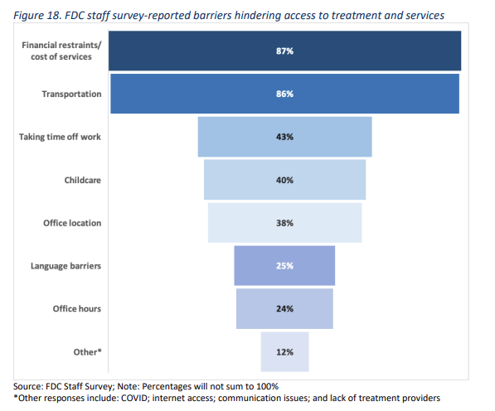
Officer Identified Challenges to Successful Supervision Completion
Notes:
Valori Oliver LEADS
Improving Outcomes and Safely Reducing Revocations from Community Supervision in Florida https://www.cjinstitute.org/assets/sites/2/2022/07/Florida-Revocation-Analysis-Report-FINAL_7.13.22.pdf
Staff consistently identified a lack of resources, high caseloads, and diminished autonomy as challenges impacting their ability to focus on helping individuals succeed on supervision A reoccurring theme across focus group interviews was the lack of resources staff feel they have available to them to help individuals on their caseload succeed on supervision. This finding was further supported by the survey conducted by CJI. Nearly 90 percent of staff who responded to the survey stated they did not have the necessary resources to help clients overcome barriers to success. Staff also expressed concern with the high caseloads that many officers have. Fifty-nine percent of survey respondents indicated their caseloads were in the range of 51-100 individuals.
Another recurring theme noted during focus group interviews and staff survey responses was the desire officers have for more autonomy in making decisions regarding individuals on their caseload. During focus group interviews, staff expressed a lack of autonomy in responding to violations, with 82 percent of surveyed officers reporting that they do not have discretion to the decide when to recommend revocation.
Reference the 7/22 crime and justice institute’s report on Improving Outcomes and Safely Reducing Revocations from Community Supervision in Florida and the recommendations to address three of the critical areas in improviding community supervision outcomes in florida:
1. Remove barriers to supervision success;
2. Focus resources on the highest-risk individuals; and
3. Ensure long-term sustainability of evidence-based practices.
The document provides a comprehensive overview of these areas and recommendations to address and improve each area.

Slide 18
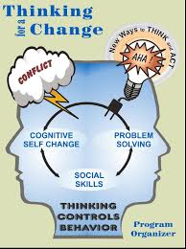
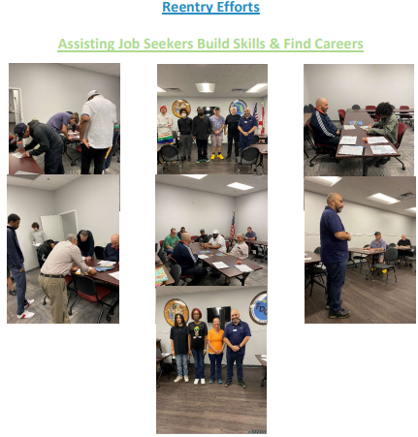
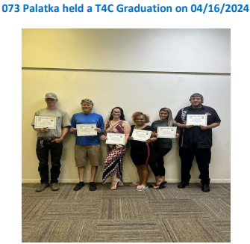
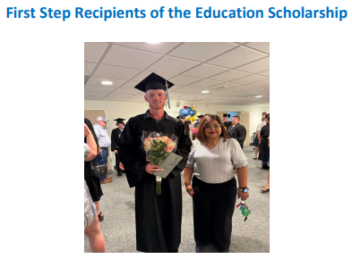
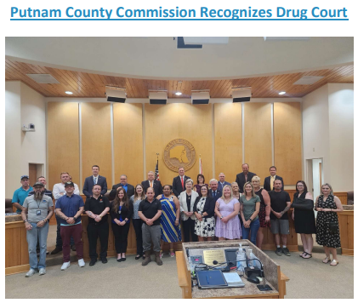
How probation breaks down barriers
RE-ENTRY PROGRAMS
GOVERNMENT OPERATION CONSULTANT
FIRST STEP
THINKNG FOR A CHANGE (T4C)
F.A.C.E I.T
POST –RELEASE SUBSTANCE ABUSE TRANSITIONAL HOUSING (PRSATH)
RE-ENTRY SEMINARS
MOBILE PROBATION UNIT (MPU)
P.I.T CREW
MOBILE RE-ENTRY UNIT (COMING 2025)
EMPLOYMENT REFERRALS
JOB FAIRS
HOUSING INFORMATION
EDUCATION RESOURCES
FOOD PANTRY INFORMATION
MEDICAL/INSURANCE INFORMATION
RESOURCE GUIDE
BUS PASSES
PUBLIX GIFT CARDS
GOODWILL GIFT CARDS
SCHOLARSHIPS
FINANCIAL ASSISANCE
OTHER
CLOTHING CLOSET
RESOURCE BOARDS
LATE REPORTING
IOTS
Notes:
Valori Oliver Leads

Slide 19
NOT SO SECRET WEAPON
Notes:
Lead = - Valori
J Latimore jumps in and transition to Emil

Slide 20
Being A PSC PARTICIPANT
Personalized Treatment Plans
Regular Court Appearances
Accountability
Support
Therapeutic community with PSC participants
Recovery Oriented
Integrated into the community
Notes:
Lead = Emil
Key Aspects of Participation:
Personalized Treatment Plans:
Participants work closely with judges, case managers, and treatment providers to develop individualized treatment plans.
These plans often include therapy, counseling, substance abuse treatment, and other supportive services1.
Regular Court Appearances:
Participants must attend regular court sessions where their progress is reviewed.
Judges monitor compliance with treatment plans and provide encouragement, as well as impose sanctions if necessary2.
Accountability and Support:
Participants are held accountable for their actions but are also provided with the support needed to make positive changes.
The collaborative approach involves multiple stakeholders, including social workers, mental health professionals, and community organizations2.
Focus on Rehabilitation:
The primary goal is to reduce recidivism by addressing the root causes of criminal behavior.
Successful completion of the program can lead to reduced sentences, dismissal of charges, or other legal benefits3.
Community Involvement:
Problem-solving courts often engage with community resources to provide comprehensive support.
Participants may be required to engage in community service or other restorative justice activities2.
Benefits of Participation:
Reduced Recidivism: Participants are less likely to reoffend compared to those in traditional courts4.
Improved Outcomes: Many participants experience better mental health, improved family relationships, and greater stability in their lives4.
Supportive Environment: The non-adversarial, supportive environment helps participants feel more engaged and motivated to succeed3.

Slide 21
Peer support specialist
Notes:
Lead = Emil

Slide 22
Reducing Recidivism Potential for Successful Reentry: Peer Recovery Support Services
Peer recovery coaching and peer mentoring are processes that help justice-involved individuals:
Explore the prospect of living a “better life” than before
Develop practical approaches & strategies to setting and achieving goals
Build trust with those they are or may be receiving services and supports from now and in the future
Develop the determination, perseverance, dignity, responsibility and hope needed for successful reentry
Notes:
Lead- Emil

Slide 23
probation
Notes:
Lead = Valori

Slide 24
INCENTIVE(S)
PSC:
Teams
Fewer Status Hearings
Top of docket
Travel permission
Way to Go Award
Notes:
Compare and Contrast
Lead – Valori & J Latimore

Slide 25
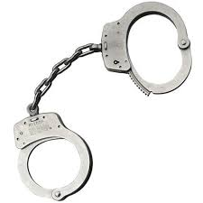
SANCTIONS
PSC:
Judicial Warning
Community Service Hours
More Frequent Status Hrgs
Pro-social activities
More intensive treatment
More intensive supervision
Jail
Notes:
Compare and Contrast
Lead – Valori & J Latimore

Slide 26
New Arrest/VOP
Notes:
Compare and Contrast
Lead – Valori & J Latimore
Transition into Emil

Slide 27
Perspective of a psc graduate
Reduce Recidivism
Improved Outcomes
Supportive community
Basic needs
Second chance at life
Notes:
Lead = Emil

Slide 28
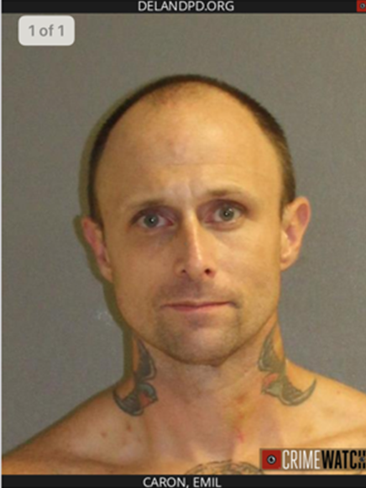
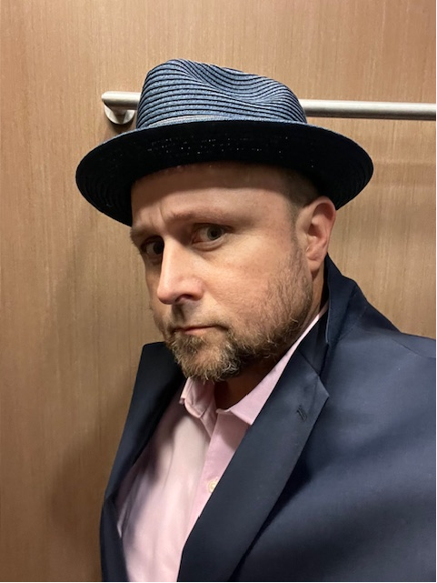
Mission accomplished
Notes:
Lead - Emil

Slide 29
Questions?

