Slide 1
Managing Challenging Human Interactions: the Benefits of Emotional Intelligence
Presented by Sergeant Sam Vasquez
and Kathleen Bregel
Seminole County Sheriff’s Office

Slide 2
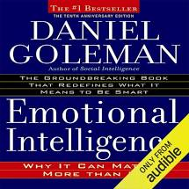
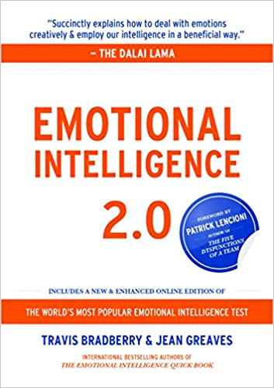
What is Emotional Intelligence?
Emotional Intelligence (EQ or EI) is a term created by two researchers – Peter Salovey and John Mayer – and popularized by Daniel Goleman in his 1995 book of the same name.
We define EI as the ability to:
Recognize, understand and manage our own emotions (and behaviors)
Recognize, understand and influence the emotions of others (to improve relationships)

Slide 3
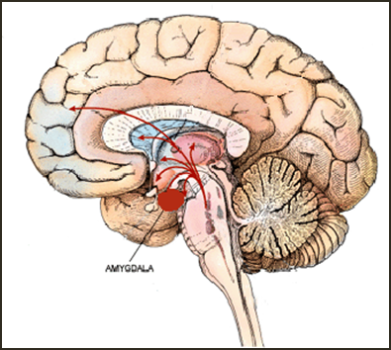
Amygdala - Emotional Memory Bank
The Amygdala
is the site where emotions and experiences are stored
plays the central role in the way you emotionally respond

Slide 4
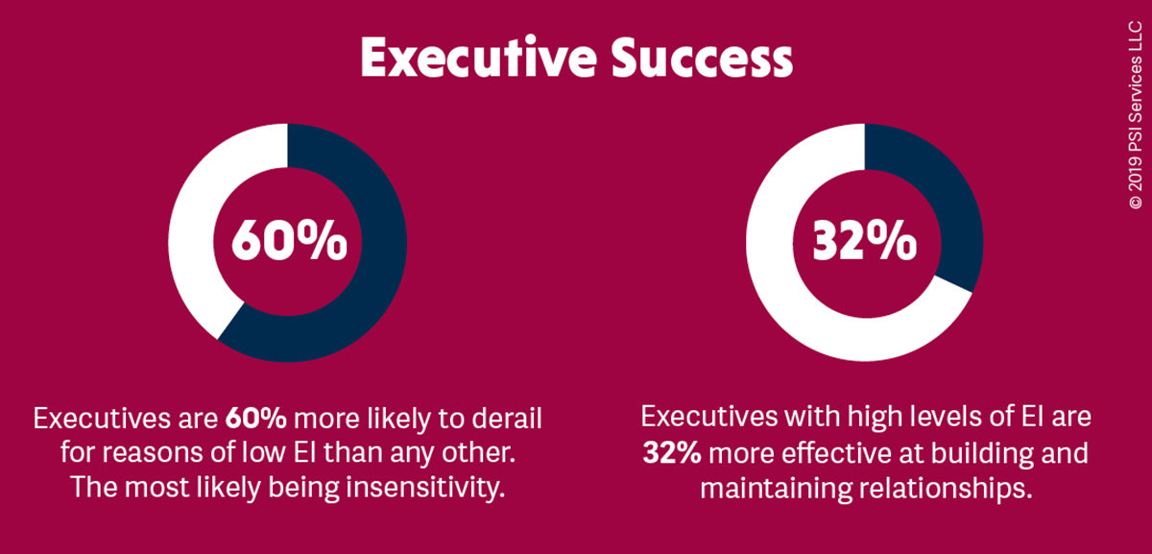
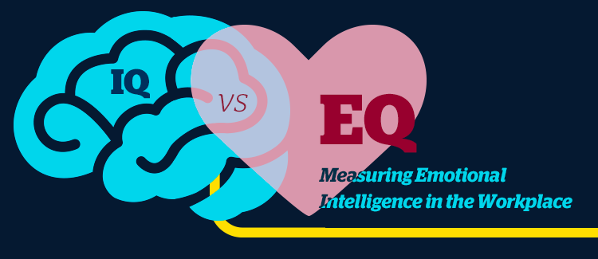
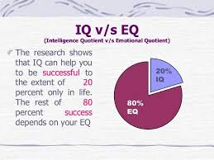
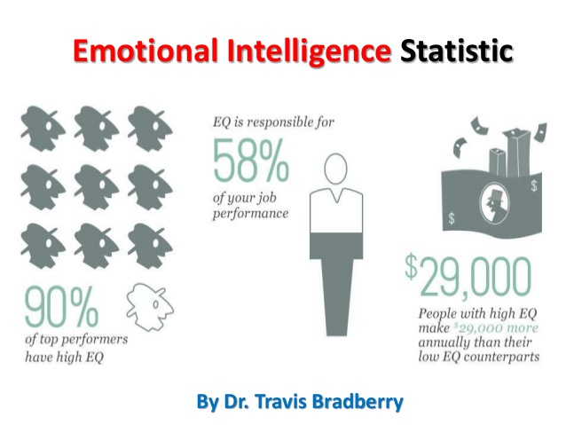

Slide 5
Why EI for Law Enforcement?
Controls the instinct to survive
Keeps one calm in emergencies
Aids accurate decisions under stress
Improves mental and physical health
Consider EI of those we serve

Slide 6
The Four Emotional Intelligence Domains

Slide 7
Self Awareness

Slide 8
Self Awareness
It’s all about Energy
Honest Reflection
Willingness to Grow
What are your triggers

Slide 9
Self Management

Slide 10
Self Management
To act or not act
Control your thoughts and reactions
Protect your Energy at all costs
Do not sweat the small stuff

Slide 11
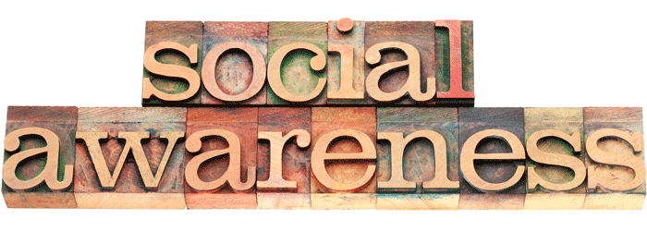
Being socially aware means that you accurately pick up on the emotions in other people and understand what is really going on with them. The net result of social awareness is the ongoing development of social skills.

Slide 12
Social Awareness
Listen and observe
Empathize with others
Respect different opinions
Mindful of surroundings

Slide 13
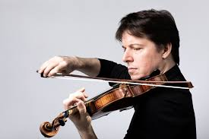
Joshua Bell and the Washington Post Subway Experiment.flv

Slide 14
Relationship Management

Slide 15
Relationship Management
Surround yourself with Lions
Do a spring cleaning of your negative relationships
(Ensure relationships are not energy vampires)
Effectively handle conflict / differences
Always think win-win

Slide 16
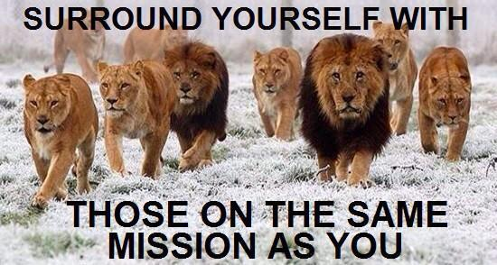

Slide 17
Emotional Intelligence Summary
Use your self-awareness skills to notice your emotions and understand what is happening.
Use your self-management skills to express your emotions effectively, and act accordingly to benefit the connection.
Use your social awareness skills to better understand the other person’s needs and feelings.
If you want a relationship that has staying power and grows over time, and in which your needs and the other person’s needs are satisfied, then relationship management taps into all the EQ skills.

Slide 18
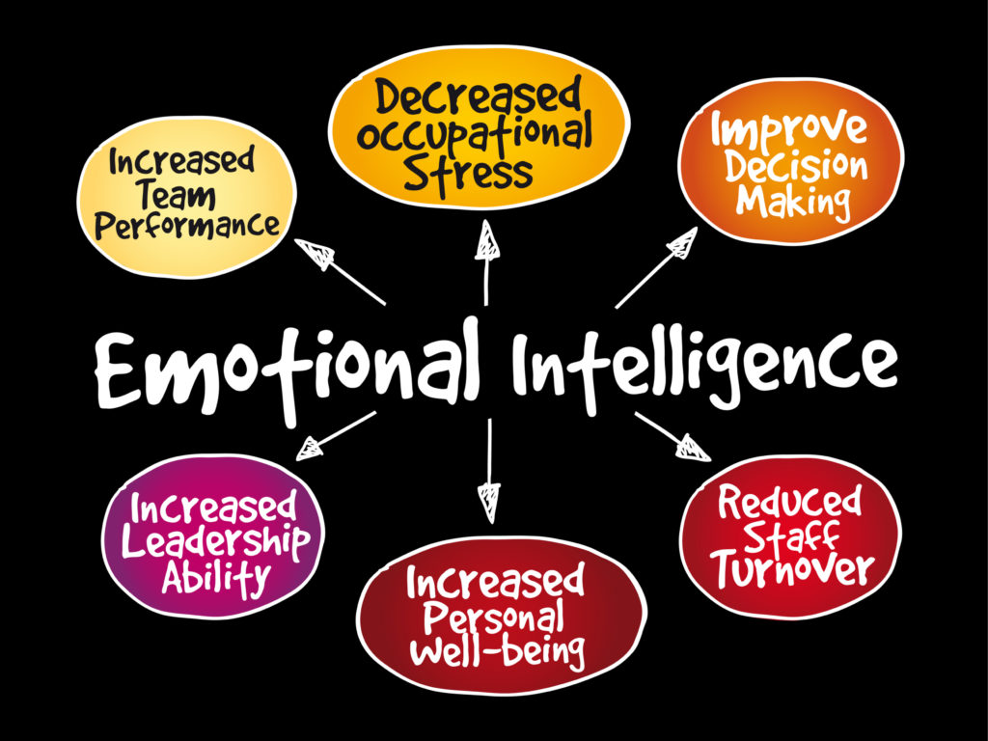

Slide 19
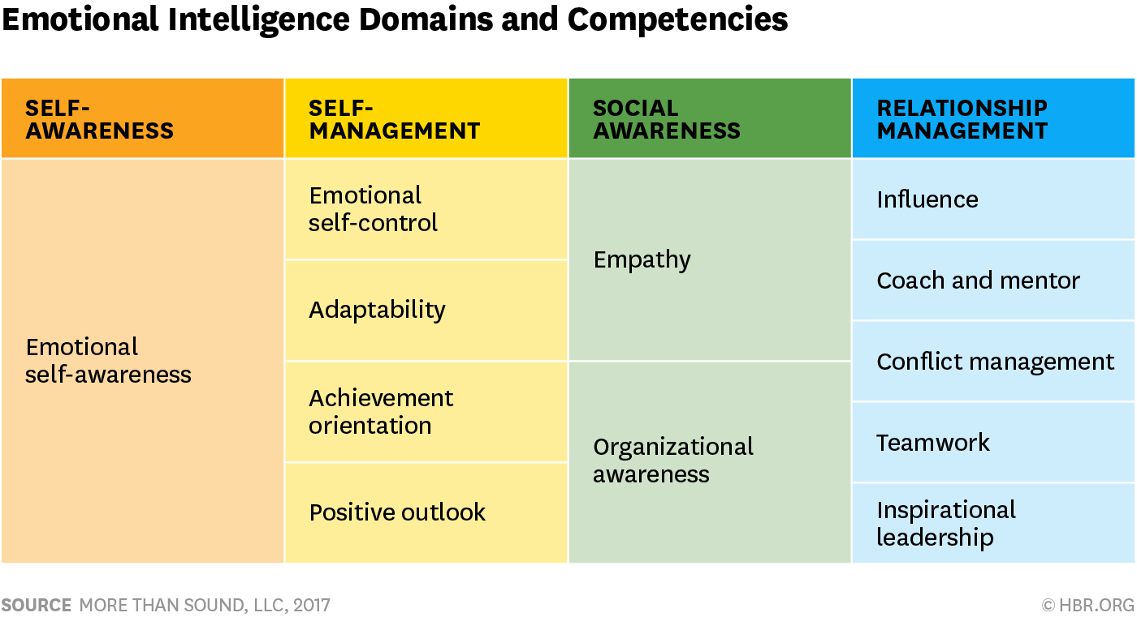

Slide 21
Final Thoughts on Emotional Intelligence
Emotional Intelligence can be learned.
These skills can help you maintain stability within your organization.
If the human element is ignored, then nothing else will work as well as it should.
Companies where people work together will have competitive edge, and with the help of emotional intelligence the group will be more productive.
You can improve your own EI.

Slide 22
Questions/Comments

Slide 23
Sam Vasquez Cell: 407-402-3574 svasquez@Seminolesheriff.org Kathleen Bregel Cell: 321-304-7862 kbregel@Seminolesheriff.org

Slide 24
PositivePsychology.com https://positivepsychology.com/emotional-intelligence-exercises/ Institute for Health and Human Potential https://www.ihhp.com/resource-center/ Additional Resources https://hpsys.com/EI_Resources.htm https://www.linkedin.com/pulse/twelve-competencies-emotional-intelligence-daniel-goleman
Resources

